Slide 1

Applying Artificial Intelligence to the industry
2016. 11. 2

Slide 2
Table of Contents
Artificial Intelligent Impact on economy and industry
Expected consideration of AI value in applying to industry
Various aspects of AI systems
Key issues for future application development
Conclusion

Slide 3
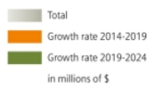
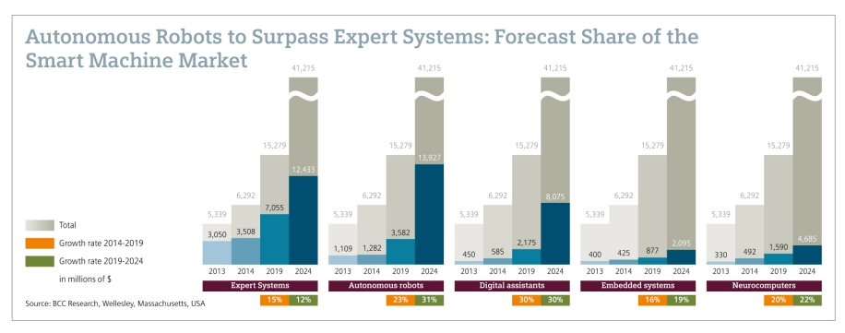
AI Market Impact
AI Status & Market Share
The global market for smart machines will grow to $15.3 billion by 2019 (* BCC research, 2014)
(`14) $6.3billion → (`19) $15.3billion → (`24) $41billion (CAGR 19.7%) *source : BCC Research, May 2014
Market Share : Autonomous robots > Expert Systems > Digital assistants > Nurocomputers > Smart embedded systems
Autonomous Robots to Surpass Expert Systems : Forecast Share of the Smart Machine Market

Slide 4
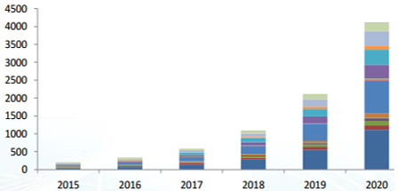
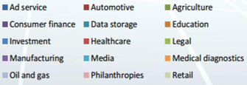
AI Market Impact
AI Status & Market Share
In 2020, artificial intelligence-related sales will increase in many applications. (* Tractica, 2015 )
Advertising and investment advisory services sector will be driven by artificial intelligence.
Manufacturing, resource management and media sector will also be driven by artificial intelligence.
Application Specific World AI Related Sales Forecast
Media
Investment
Ad Service
Notes:
인공지능 현황 시장전망

Slide 5
AI Social Impact
AI will make a big impact on industry and human life
[ Artificial intelligence applied industry-specific forecasting future economic impact (in billion dollar) ]
Artificial intelligence technology | Industry | Impact scale (2025년)
Knowledge work automation | Knowledge-based industries in the financial, legal, medical | 5,200~6,700
 |  | 140 million people manpower
Robot application | Automation of production, medicine, agriculture | 1,700~4,500
 |  | Improve labor for 50 million people with disabilities in effect
Self driving | Automated route searching and traveling | 200~1,900
 |  | Prevention effect for 3 ~ 15 million people of traffic accidents sacrifice
* By McKinsey
Job replaced with Artificial intelligence
Foxconn : Factory Automation
Boston Dynamics : Robot soldiers
Law Intelligence / High Frequency Trading
Kiva Systems (Amazon) : Warehouse worker
Microsoft, Google, Facebook, Softbank : Chat-bot
Replacing Job
Executive Secretary……….4759 Manufacturing…1609 Mining…………….497 Design…………….151 Law………………..109
Raising Job
Financial Management..…...492 Management….…416 Computer Mathematics....….405 Architecture.…….151 Sales………….…..109
* By World Economy Forum

Slide 6
AI on the rise, again
AI is on the rise again, deep learning
AI 1st Phase
AI 2nd Phase
AI 3rd Phase
`1950 ~ `1960
`1980
`1990 ~ `2000
Fast calculation
Rejecting complex problem
Expert system
Difficult to define the knowledge
Searching engine is developed
Machine learning from big data
3rd Phase
Innovative solution
2nd Phase
1st Phase
Deep learning with BIG data
`1960
`1970
`1980
`1990
`2000
`2010
* “The History of Artificial Intelligence”, Univ. of Washington, 2006
* “Deep learning for detecting robotic grasps”, Ian Lenz, Cornell University, 2015

Slide 7
Deep learning, current issues
Deep learning is current issues and AI keyword
Deep learning makes AI a better learning machine
Overcoming the basic weakness
Powerful GPU
Big data is a good trainer
AI with deep learning is core technology leading industry 4.0
Extreme automation makes complex decisions
Rising to new business models
Smart algorithms
Industrial Revolution
Machine
Auto labor act.
Better Deep Learning
Lots of training data
?
Cloud computing
AI
Auto intel. act.
* “Deep learning”, Yann LeCun, Director of A.I. Research at Facebook, 2015
* “Importance of Deep learning”, Prof. Jong-Tae Lee, Univ. of Dong-guk, 2016
* “Extreme automation and connectivity”, UBS investment bank ,2016

Slide 8
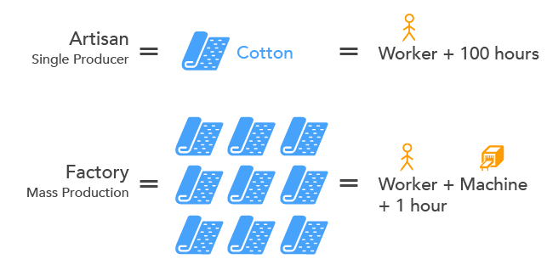
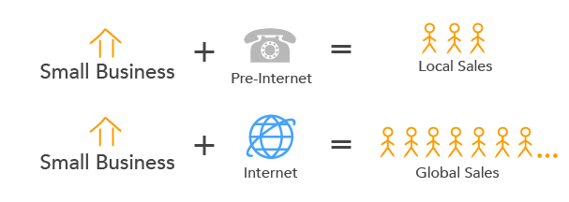

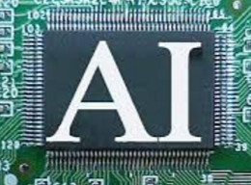

What are the expected values of industry application
Appling AI to the industry, the value is important
Considering economic value, AI is applied with the industry (* kipthis.com) (* “Extreme automation and connectivity”, UBS investment bank ,2016)
Technical revolution must be applied firstly to the industrial area according to the economic standard (* “Only the Paranoid Survive”, Andrew S Grove)
Cotton industry in the industrial revolution (* Manchester, 1951)
The 1st Industrial Revolution Impact
Small business with the Internet (* MIT Tech, 2014)
Internet Revolution Impact
What industry with artificial intelligence?
The 4th Industrial Revolution – AI Impact

Slide 9

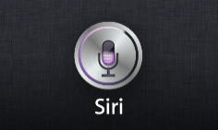

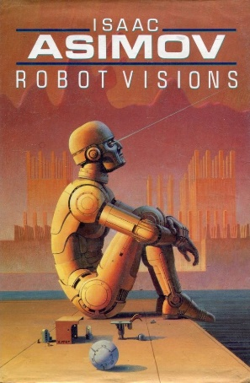

Definition of AI
* http:// www.cse.buffalo.esu/
Name | Year | Definition
Marvin Minsky | 1968 | “The science of making machines do things that would require intelligence if done by humans”
Artificial Narrow Intelligence | non-sentient A.I. that is focused on 1 task no genuine intelligence, no self-awareness in Ted Greenwald wrote (2011) : "The iPhone + Siri = hybrid AI. Combining AI techniques → massive data in the cloud."
Artificial General Intelligence | performing any intellectual task like a human with the ability to apply intelligence to any problem accomplish specific problem solving

Slide 10

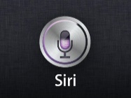

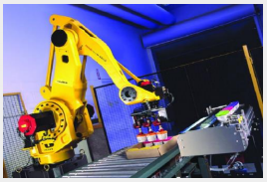
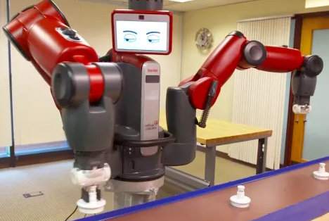
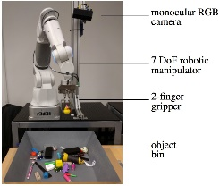
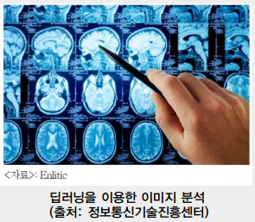
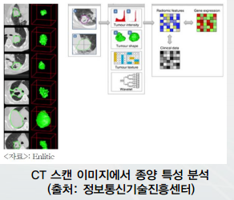
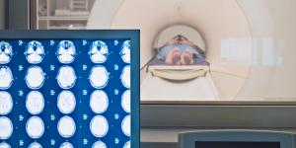


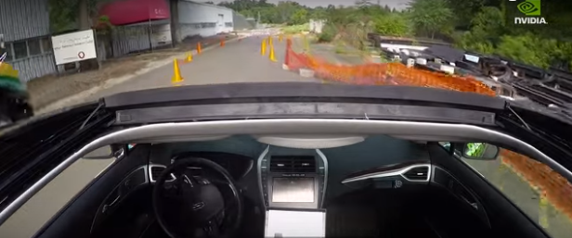
Artificial Intelligence Applications
AI is being applied to various industry applications
General
Information
AI
Amazon Echo
Apple SIRI
Google Assistant
Fanac Industrial Robot
MIT Baxter
Google Assemble Robot
Target
Task
AI
CT Image Analysis
Tumor Analysis
Cancer Analysis
NEST smart sensor
Apple - iHome
nVidia Self Driving Car

Slide 11


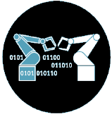


Expected R&D issues for Applying AI to the Industry
To apply AI to the industry having the economic value, it is urgent to develop the technologies including embedded, optimization, security and safety
Main industry
Embedded
Smart Factory
Reliability
Smart Home, Energy & Privacy
Security
Artificial Intelligence
Safety
Health-care & medical
* “Readings in distributed artificial intelligence“, Alan H. Bond, California Institute of Tech., 2014 * “Learning in Embedded Systems”, L.P. Kaelbling, MIT Press, 1990

Slide 12
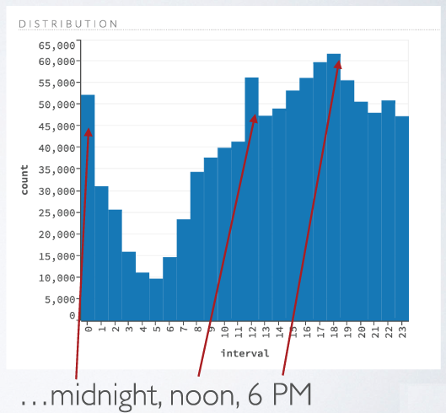


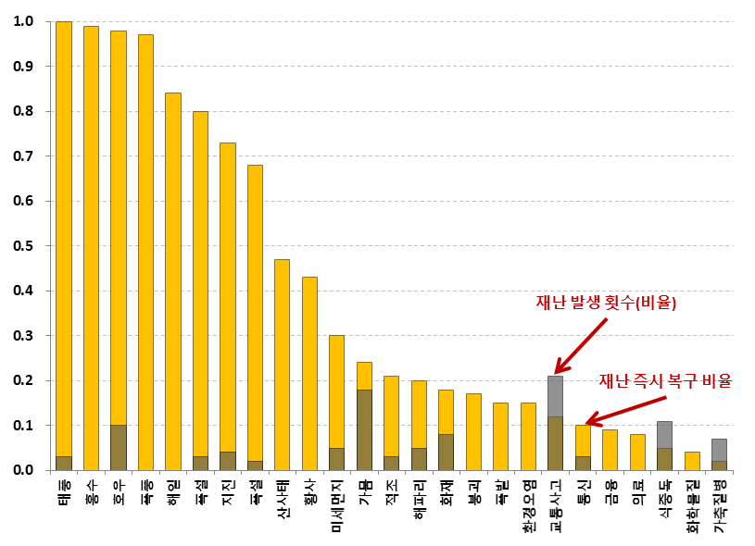


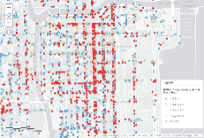
Data Processing Steps in AI
Data Processing
Learning / Reasoning
& Decision
Analysis
Structured / Unstructured
Statistical operation
Knowledge Base
High speed processing
Clustering / Classification
Prediction
Big Data processing
Model creation
Structured & unstructured
Video, Text processing
Decision processing
Data normalization
Intelligence
Machine Learning
Reasoning / Decision
Cloud computing
Embedded computing
Reliability
Safety, Security
IoT Data
Context processing
Embedded,Reliability
Distributed, Security
Artificial Intelligence ability must have
reason, use strategy, solve puzzles
make judgments under uncertainty
represent knowledge, including commonsense knowledge
plan
learn
communicate in natural language
integrate all these skills towards common goals

Slide 13
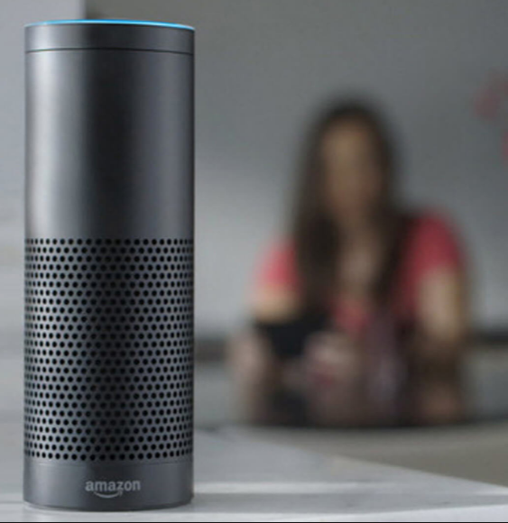
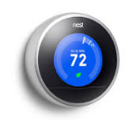
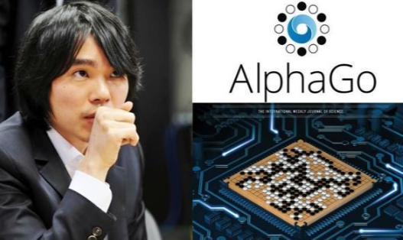
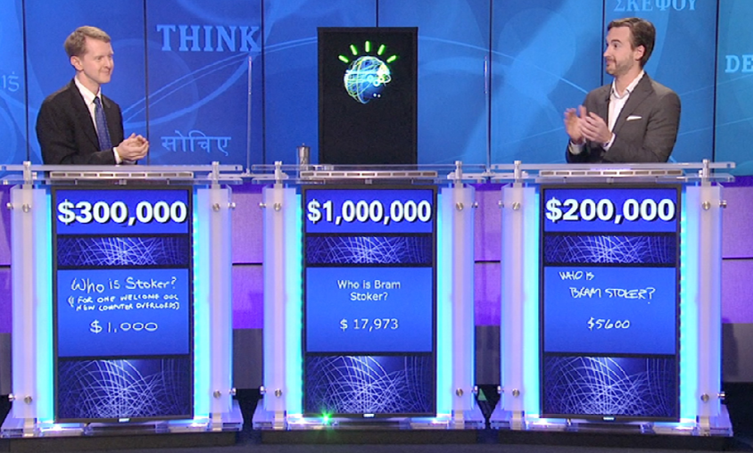
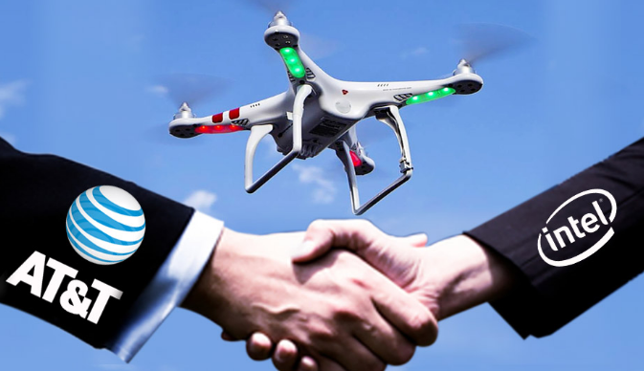
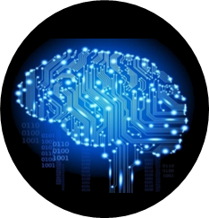






AI Service will be embedded in various devices
Centralized AI system which supports us
Cloud central system process
Heavy, extreme data analysis with high-level accuracy
Embedded AI system is around us
Embedded AI system in distributed network
Light-weight and reasonable accuracy
Google
IBM
Amazon Echo
Google Nest
AT&T/intel Drone
High
Performance
Distributed computing
Embedded
Reliability
Security
Safety
* “Readings in distributed artificial intelligence“, Alan H. Bond, California Institute of Tech., 2014 * “Multiagent Systems : A modern approach to distributed artificial intelligence“, Gerhard Weiss, MIT, 1999

Slide 14
Small Data Processing for AI Systems
Small vs Big data for AI
Previous small data for machine learning
Traditional machine learning
Shallow learning with small data, for the exact task
New small data
Small data is all around us, in personal level, which has unique signature of our life
It has key meaning of context around us
It uses big data / deep learning based data pattern process for the holistic capture of meaning
Detail and real-time stream data give us reasonable information of current data trend
Big data for machine learning
Deep dive into historical data process
Identify patterns and relationships
Big data has a snap shot and glimpse of data pattern, thus lack of current detail information
“The hype around big data is misplaced small, linked data is where the real value lies” - Rufus Pollock
* Small Data vs. Big Data : Back to the basics, Ahmed Banafa

Slide 15
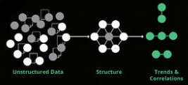


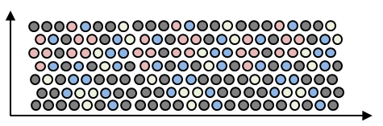

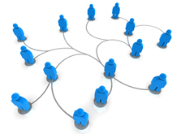
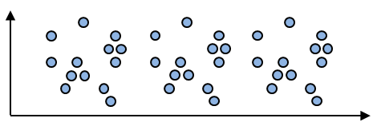
Small Data Processing for AI Systems
Small data holds meaningful information of spatial and time domain
Meaningful Small data
Meaningful small data is a dataset that contains very specific attributes
Determine current states and conditions or may be generated by analyzing larger data sets
Provides current detail information
In a long-time history, small data can capture meaningful pattern of data with small set of samples
In a spatial consideration, small data describes exact information around us, which is more valuable for the clear context-awareness
Small data which is meaningful
User
Small data over time
Small data around user

Slide 16
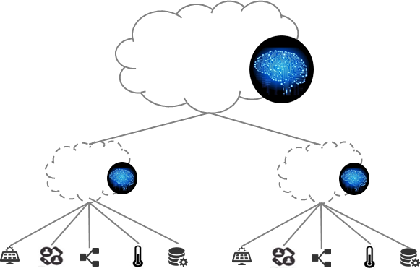
Small Data Processing for AI Systems
Small data processing architecture
Small data service feature
Easy to create and access to our data
Solving real world problem
Learning new experiences
Real-time decision
Management of near IoT including us
Cloud intelligence
Embedded Intelligence
Devices
Small data system
Bridge real world data to the cloud
Connect to cloud big data service
Enable to collaborate with big data service
Local intelligence for the service
Filtering and transforming Data
Learning or passing relatively less-clear data to server
engine
co-work
engine
Cloud intelligence
Intelligence set
all data
error
update
small data processing
Embedded intelligence
Intelligence set
all data
Devices

Slide 17
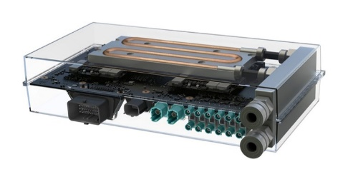
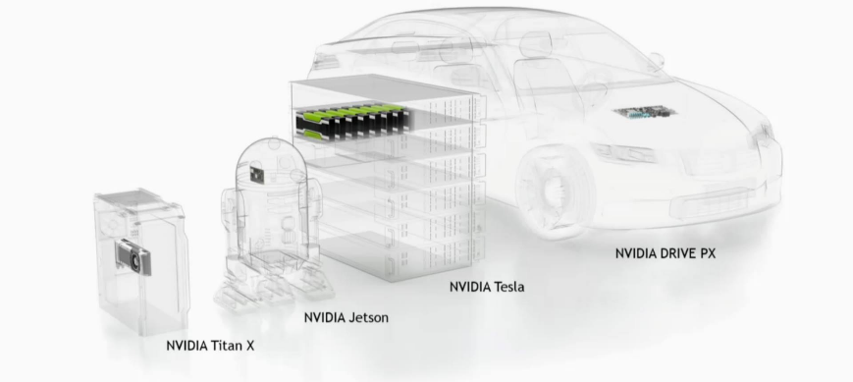
Fit intelligence performance in system
Tuning parameter to improve performance for embedded systems
Learning Rate – neuron system on processing stress
Network Topology – select whether wide or deep
Accuracy of sub AI system can be managed from central AI system
Dropout: randomly drop units (along with their connections) from the neural network during training
Embedded machine for special application
Standard Neural Net
Modified Neural Net
* “Dropout: A Simple Way to Prevent Neural Networks from Overfitting”, Nitish Srivastava, University of Toronto
* “Wide & Deep Learning: Better Together with TensorFlow “, Heng-Tze Cheng, Google Research, 2014
* “How To Improve Deep Learning Performance “, Jason Brownlee, machinelearningmastery.com, 2016

Slide 18
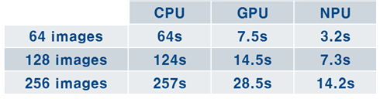
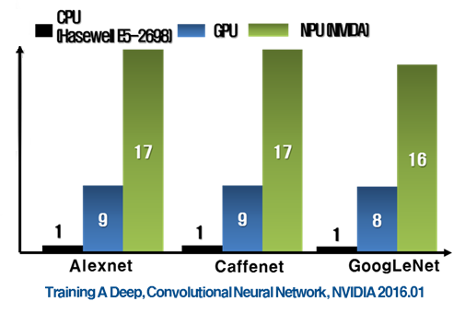
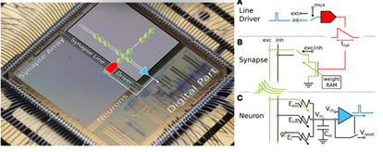
Improving performance on embedded system
Object tracking in image (sec.)
Neuromorphic computing helps embedded AI
Neuron parallel processing
Memory like human brain, neuron and synapse
Low-power processing
Memristor based SoC
Hybrid Memristor SoC
Switching and memory component
Hybrid microscale, nano scale SoC

Slide 19
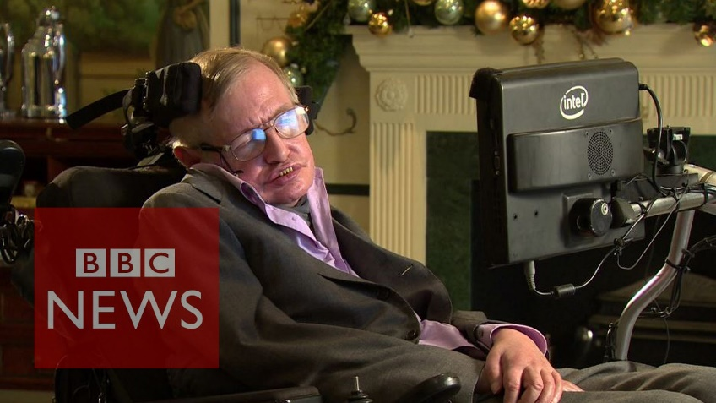
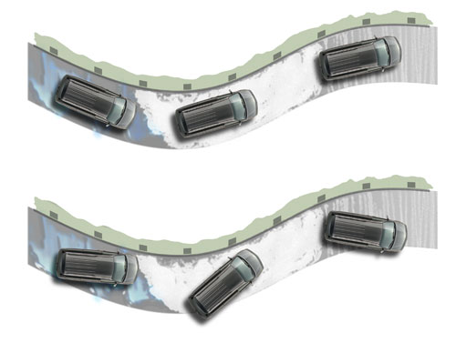
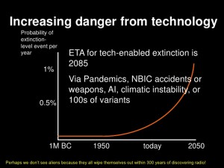
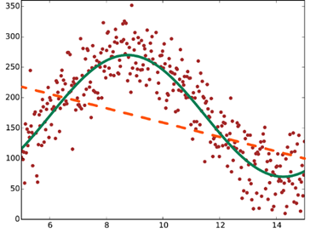
Providing Safety with AI
Providing safety control
Safe zone
Dead zone

Slide 20



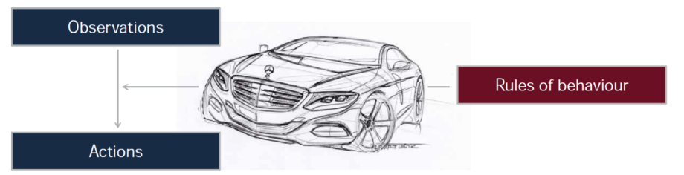
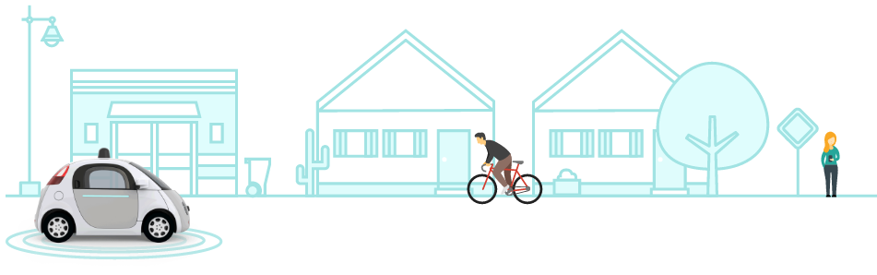
Application : self-driving car
Sensing its environment and navigating without human involvement
Car sensing, understanding of road condition big data
Traffic pattern analysis and scheduling the driving
Embedded system with high performance of deep-learning
What : Scene
Where
Embedded
High performance embedded system
Sensing, observation, understanding
Supports deep learning by itself
Routing
Reliability
Many sensors and fusion data
Real-time response of event
Self-detecting, healing
Safety
Careful of pedestrian
Accident with other cars
Saving life from car accident
* https://www.google.com/selfdrivingcar

Slide 21
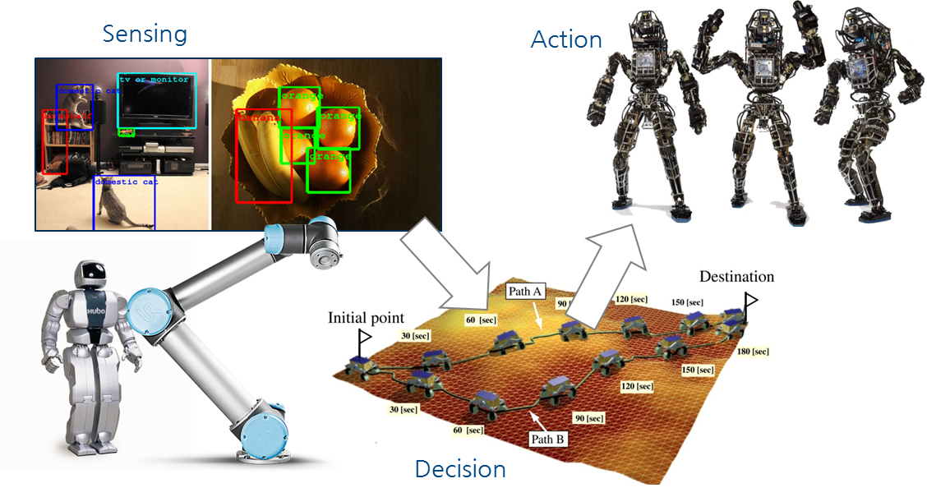
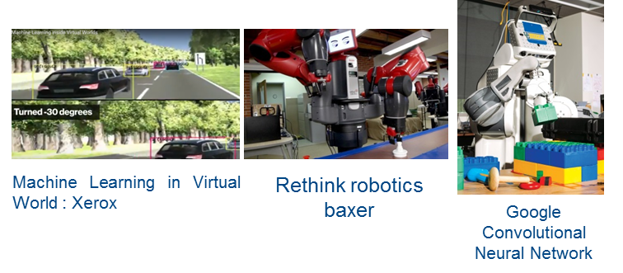
Application : intelligent robot
Sensing and action by interaction of robot components
Service commercialization with direct interaction of components on the first stage
Deep learning could solve the high-level decision problem
Higher accuracy of decision needs training data set from large-scale simulator system
Embedded
High performance embedded system
Sensor, actuation integration
More processing power for learning
Reliability
Mechanical operation should have long time stable working time
It grows the number of robots in the factory, more manageable functions should be
Safety
Robot will replace human work, after that work together with human in some where, it means that robot should have safe gab for co-work human beings
Robot should have ethics about human life

Slide 22
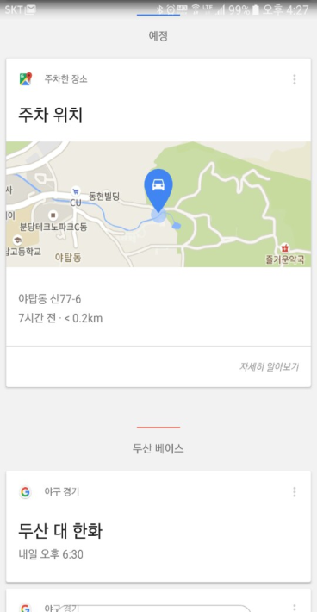
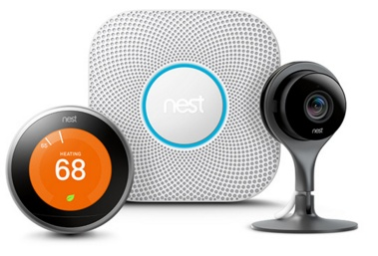
Application : intelligent home
Smart, intelligent home is the place where AI service starts
Many devices in the house, which now have network capability
Home device can hear from user through broadband and smart phone
Every machine will have intelligence in itself and start to talk each other device
Google Assistant
Keep learning the user action
Voice Recognition
NEST Platform
Keep learning the user action of device control
Collaborate with smart phone and devices
Smart thermostat controls home device from signaling of smart phone which monitoring user activity
Camera, sensor, actuator can talk each other on the NEST platform
Embedded
Network connection to other device
IoT Platform functions, web service to cloud server
Reliability
Stable network service for long time
Reliable operation despite of cyber attack
Personal information and privacy issue
Parking Location
Sports schedule
Safety
Home control should be in safe condition
Context-aware function if user is out or not, service should consider people context
* http://www.nets.com

Slide 23
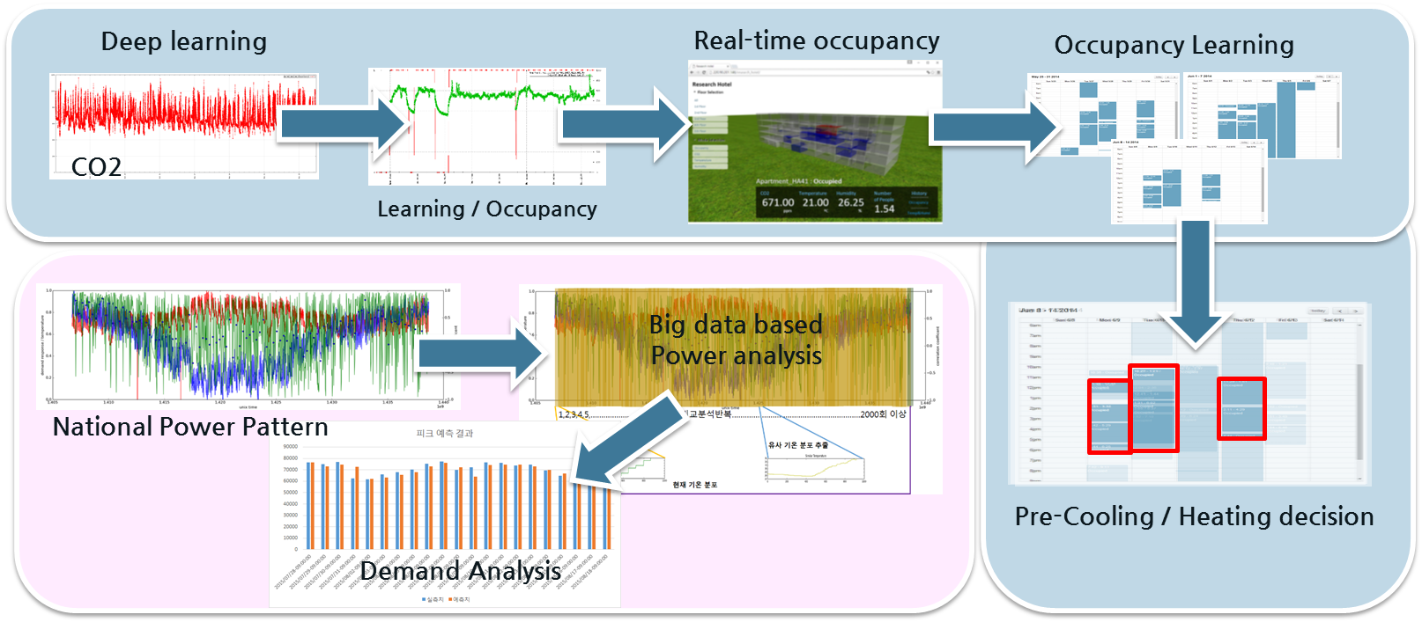

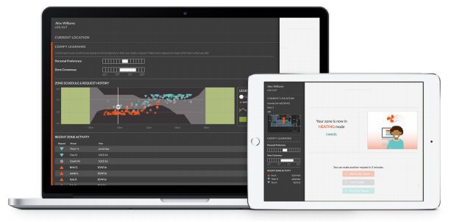
Application : intelligent energy
More energy saving with accurate prediction
Deep learning can give more accurate learning and better understanding of energy consumption pattern
Embedded
More information from embedded systems
Sensing, understanding, prediction
Adoption with convenient installation process
Reliability
Following and optimization regular operation
Long-time learning and stable operation
Safety
Careful control with indoor comfort
Mis-actuating problem
Over control against proper level
* http://www.comfyapp.com

Slide 24

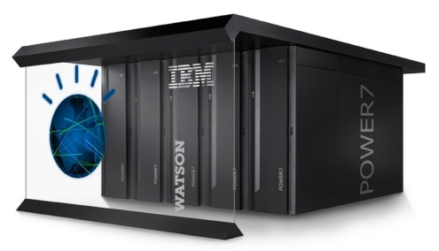





Application : AI Medical
Better treatment suggestion for individual patients
combining attributes from the patient’s file with clinical expertise, external research, and data
advanced ability to analyze the meaning and context of structured and unstructured data in clinical notes and reports, easily assimilating key patient information
keep up with the large volume of research, medical records, and clinical trials
Oncology Expert Advisor
(University of Texas
MD Anderson
Cancer Center)
Embedded
Using local intelligence to improve health monitoring
Many wearable health kit for collecting data
Keep growing the variety of health wearables
Electronic Health Records
(Mayo Clinic)
HER and Education (Cleveland Clinic)
Reliability
Decision should be careful from detail data analysis
Life science needs high level of accuracy and reliability
Safety
It need to have more information collecting to rise accuracy
Pain sensing is not enough until now, AI cannot transfer the pain to the medical analysis

Slide 25



Application : Intelligent Manufacturing
Enables visibility of all information about the manufacturing process
In the form that it is needed across entire manufacturing supply chains
Complete product lifecycles, multiple industries, small, medium and large enterprises
Provides insight for making up the economic effect and improving manufacturing quality
Embedded
Makes visibility on the process and supply chains
Cooperating sensors and manufacturing control with networking
Reliability
Ensures the stability of production system operation
Real-time response of process and manufacturing
Safety
related to employees life and health
Crucial point for the manufacturing effectiveness to avoid loss

Slide 26
Conclusion
Future AI for industry applications
There are a lot of big things coming in AI
Self-driving cars, Intelligent agents like Apple’s SIRI, Amzon’s Echo, Google’s Alpha-go, IBM’s Watson, human-like robots, and so on.
We should be careful how to adopt AI to our industry application
Let’s take the first step for potential AI applications around us
With Consideration for technical issues such as verification, validity, security and control
On this way, we have to have harmony of safety and intelligence in applications
Think about Future AI
It would be a rapid switch, when something becomes cheaper and better
AI-based medical doctor becomes cheaper, why not switch all medical doctors to smart computer, and have a few remaining human specialists for some special cases
There may be some risks of AI, but society will have to adapt, it is fate
How we will adapt is not fully clear yet for the safety. But something we’ll have to think about

